Slide 1
Cocos Creator & Firebase
Software Studio 軟體設計與實驗
Hung-Kuo Chu
Department of Computer Science
National Tsing Hua University
CS2410

Slide 2
Firebase API
Follow the steps and then you can use Firebase API in your Cocos Creator project.
Download firebase.js which TA provides
Add file to project
Set file as plugin
Set project config

Slide 3
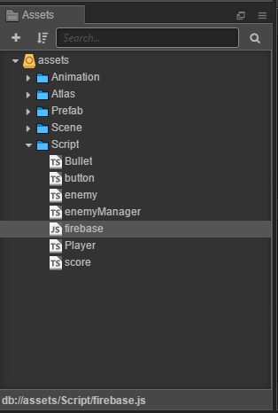
Import firebase.js
Download firebase.js file provided by TA and load it to your project.

Slide 4
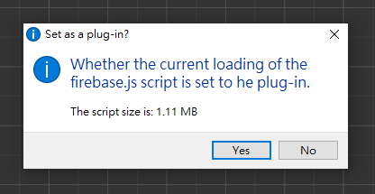
Set firebase.js as Plugin
After you drag the file to assets folder, Cocos Creator will ask you whether the file is set to plugin.
Choose “Yes”.

Slide 5
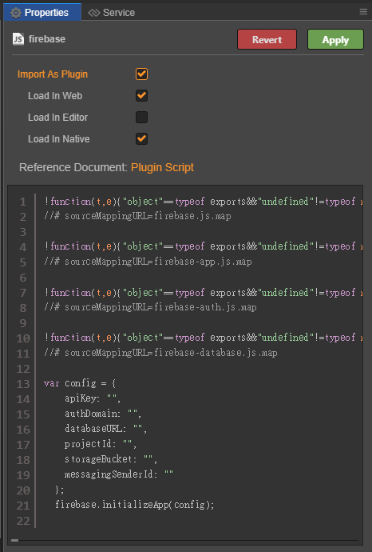
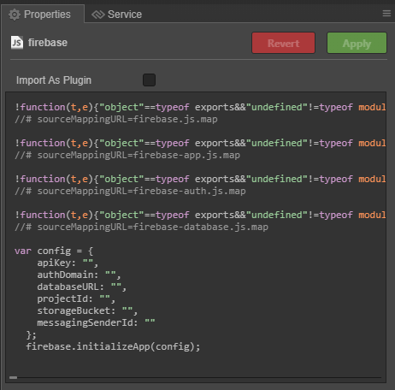
Set firebase.js as Plugin
You can also set the file to plugin manually.
Choose firebase.js, check Import As Plugin, and apply it.

Slide 6
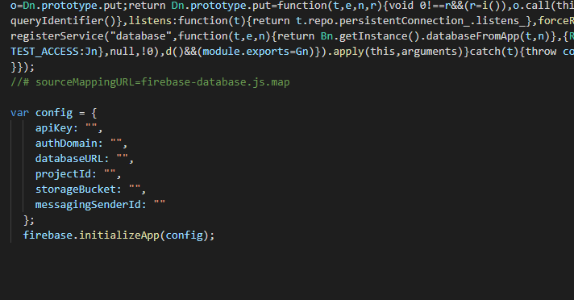
Change Config
Modify the config in the firebase.js according to your firebase config.
Change to your firebase project config!

Slide 7
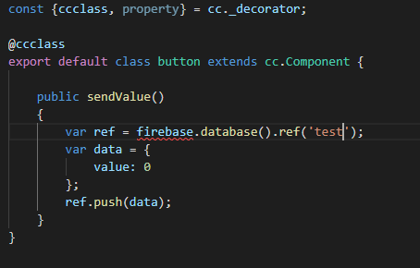
Use Firebase API
Now you can use Firebase API which we taught in class in your TypeScript scripts.
Note that the “firebase not found” error can be ignored.

Slide 8
Use Firebase API
You can put a declaration of the firebase object to make IntelliSense happy. This is completely optional.
Place the following line anywhere in your scripts or put it in “firebase.d.ts”, located at the top level of your project.
declare const firebase: any;

Slide 9
Deployment
Follow the steps then you can use firebase deploy to run your Cocos Creator project.
Build in Cocos Creator
Firebase initialization
Set public folder to build folder
Firebase deployment

Slide 10
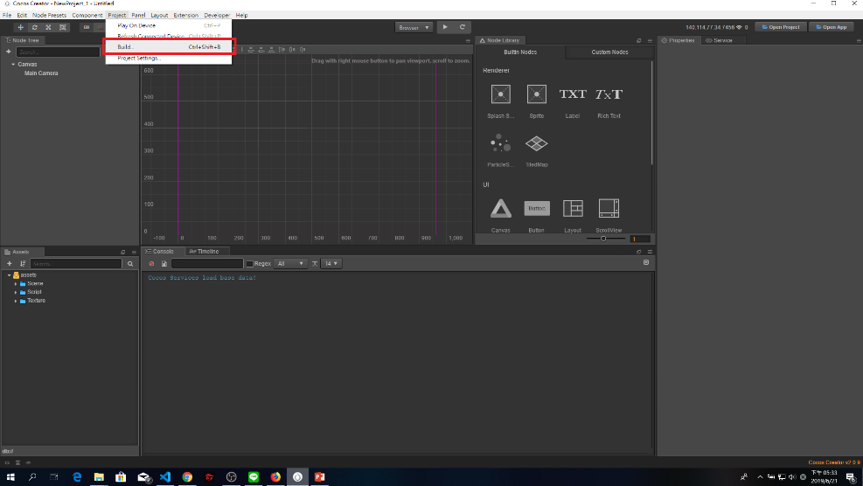
Build in Cocos Creator

Slide 11
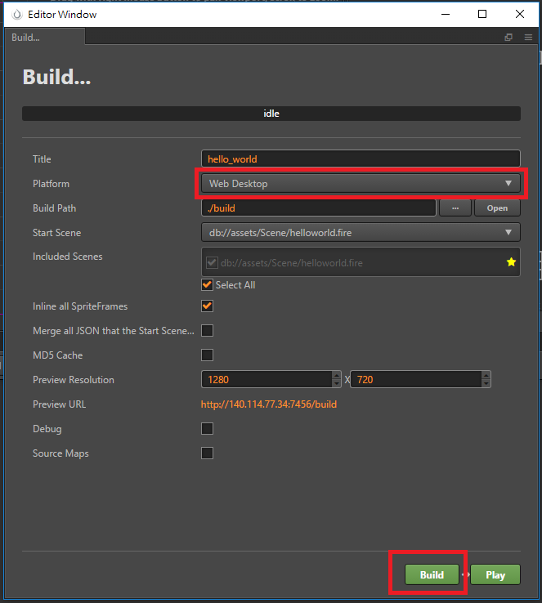
Build in Cocos Creator
1. Choose Web Desktop or Web Mobile
2. Press Build

Slide 12
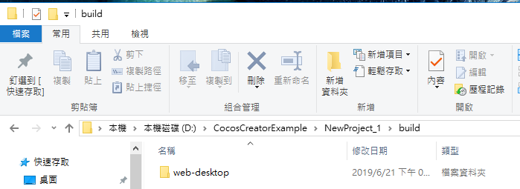
Build in Cocos Creator
If built successfully, you can find your source files in [project_path]/build/web-desktop or [project_path]/build/web-mobile

Slide 13
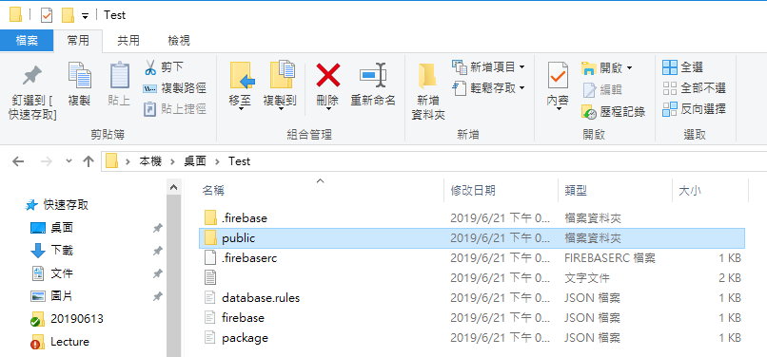
Firebase initialization
Run firebase initialization in your project’s folder. You can check lecture 6 to review how to initialize. Be careful not to overwrite your build folder!

Slide 14
Set public directory
You’ll be asked to set the public directory at the Hosting Setup step. Use the path “build/web-desktop” (or web-mobile) as your public directory, so Firebase will deploy your game using your build’s files.
If you made a mistake here, you can change it later on by editing firebase.json after initialization.

Slide 15
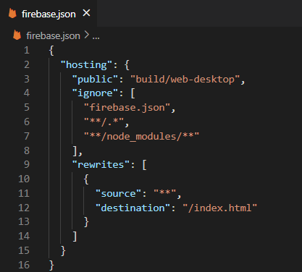
Set public directory
Your firebase.json should look something like this. Note the “public” property.

Slide 16
Firebase Deployment
Deploy your files to Firebase. You can check lecture 8 to review how to deploy.

Slide 17
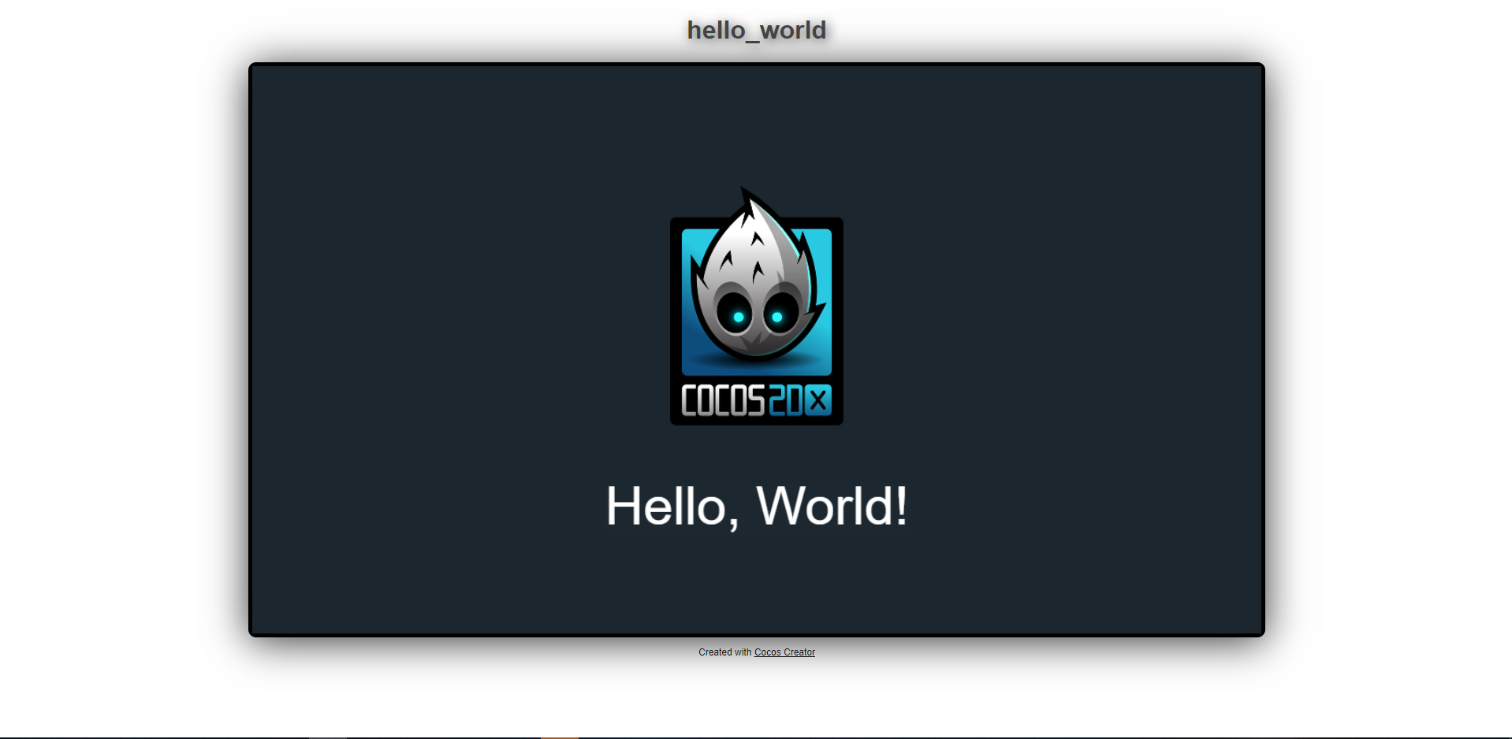
Finish
Finish all the steps, then you can see your game run on Firebase.

Slide 18





